Slide 1

Photo
Name
Address
ID
Postal Code
Phone Number
Emergency Contact
Enter Time
Pay Stubs
Availability
Apply Leave

Slide 2
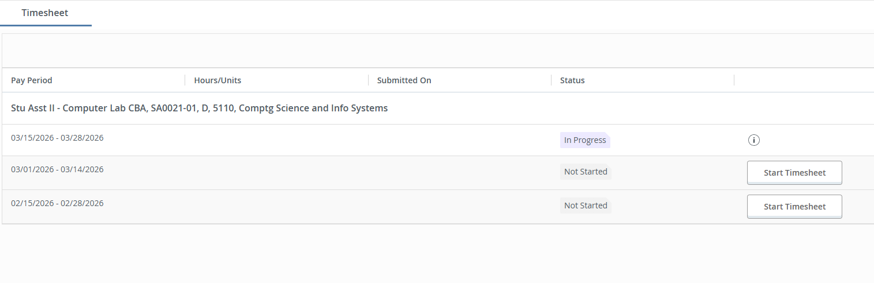

Slide 3
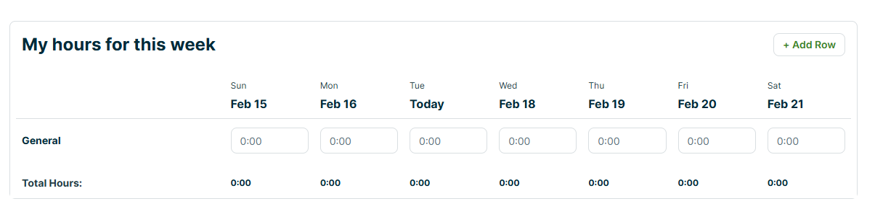

Pay Period
15-02-2026 – 28-02-2026
Week 1
Week 2
Next

Slide 4
Pay Period
15-02-2026 – 28-02-2026
Week 1
Week 2
Feb 22
Feb 22
Feb 23
Feb 24
Feb 25
Feb 26
Feb 27
Previous
Submit

Slide 5
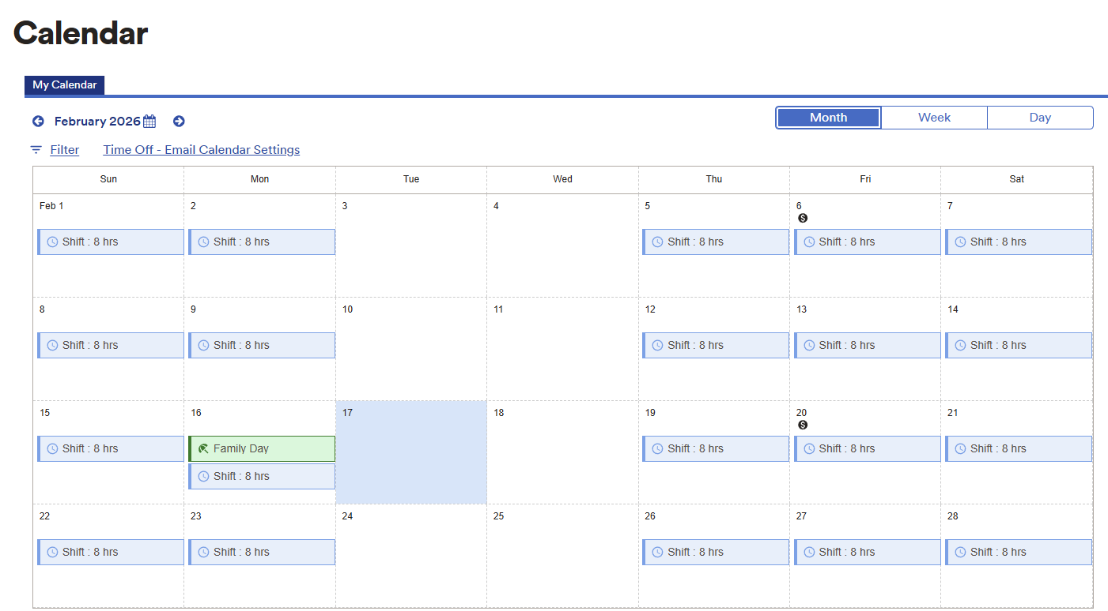
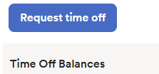
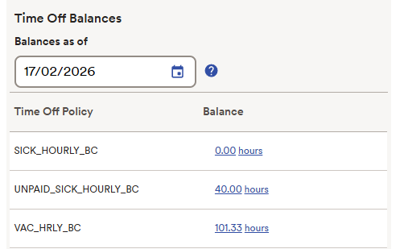
Your Schedule

Slide 6
Leave Request
Date:
Reason: (Drop down)
DD/MM/YYYY
Paid Sick/ Unpaid Sick /
Personal
Type: (Drop down)
Full Day/Half Day
Comments
Start time:
8:00 AM
////////////////////////////////////////////////////////////////////////
End time:
12:00 AM
Hours Scheduled
Hours Available
3.5 hours
40.0 hours
Previous
Submit

